Slide 1
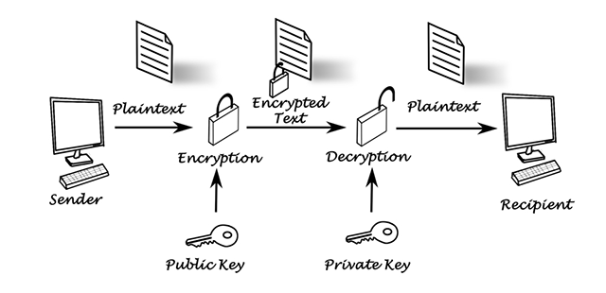
Who will it be useful for?
Governments
Spies
Organisations
The kinds of people that will use the encryption service will be people that have something that they want to hide from other people, E.g. encrypting files on servers to make sure that people aren't able to read new research that a company is doing.

Slide 2
We will include:
If we have time:
We would like:
An encrypted text chat so that the different parties are able to talk to each other without third parties being able to read the chats.
Make a peer to peer encryption update
Have the software able to send other file types like .pdf and .jpg.
Add a feature that allows users to predetermine a message that they are going to send, E.G. assign a message to send at 10pm and the message will automatically be sent at that time.

